Slide 1
STUDENT NAME:B. NANDHINI
REGISTER NO: 312219655/6B5E3CDC899770D9B814D70A362A300B
DEPARTMENT: B.COM(G) COMMERCE
COLLEGE:KANCHI SRI MAGALAKSHMI ARTS AND SCIENCE COLLEGE
FOR WOMEN .

Slide 2
PROJECT TITLE
EMPLOYEES SALARY ANALYSIS USING EXCEL

Slide 3
AGENDA
1.Problem Statement
2.Project Overview
3.End Users
4.Our Solutions And Proposition
5.Dataset Description
6.Modelling Approach
7.Results And Discussion
8.Conclusion

Slide 4

PROBLEM STATEMENT
The Salary Statement In Management Plays Important role, pay Employees The Correct Amount On Time, Common Payroll Problems Include Issuing Salary Slips To Their Employees Even Though Employers Must Issue Salary Slips To Their Employees, It Is Not Mandatory To Provide Printed Slips. For Employees, A Salary Slip Works As Proof Of Income.

Slide 5

PROJECT OVERVIEW
Employees Salary Statement Analysis To Review Though Employers Must Issue Salary Slips To Their Employees, It Is Not Mandatory To Provide Printed Slips. For Employees, A Salary Slip Works As Proof Of Income. It Provide The Detail Statements Of Expenses On Management.

Slide 6
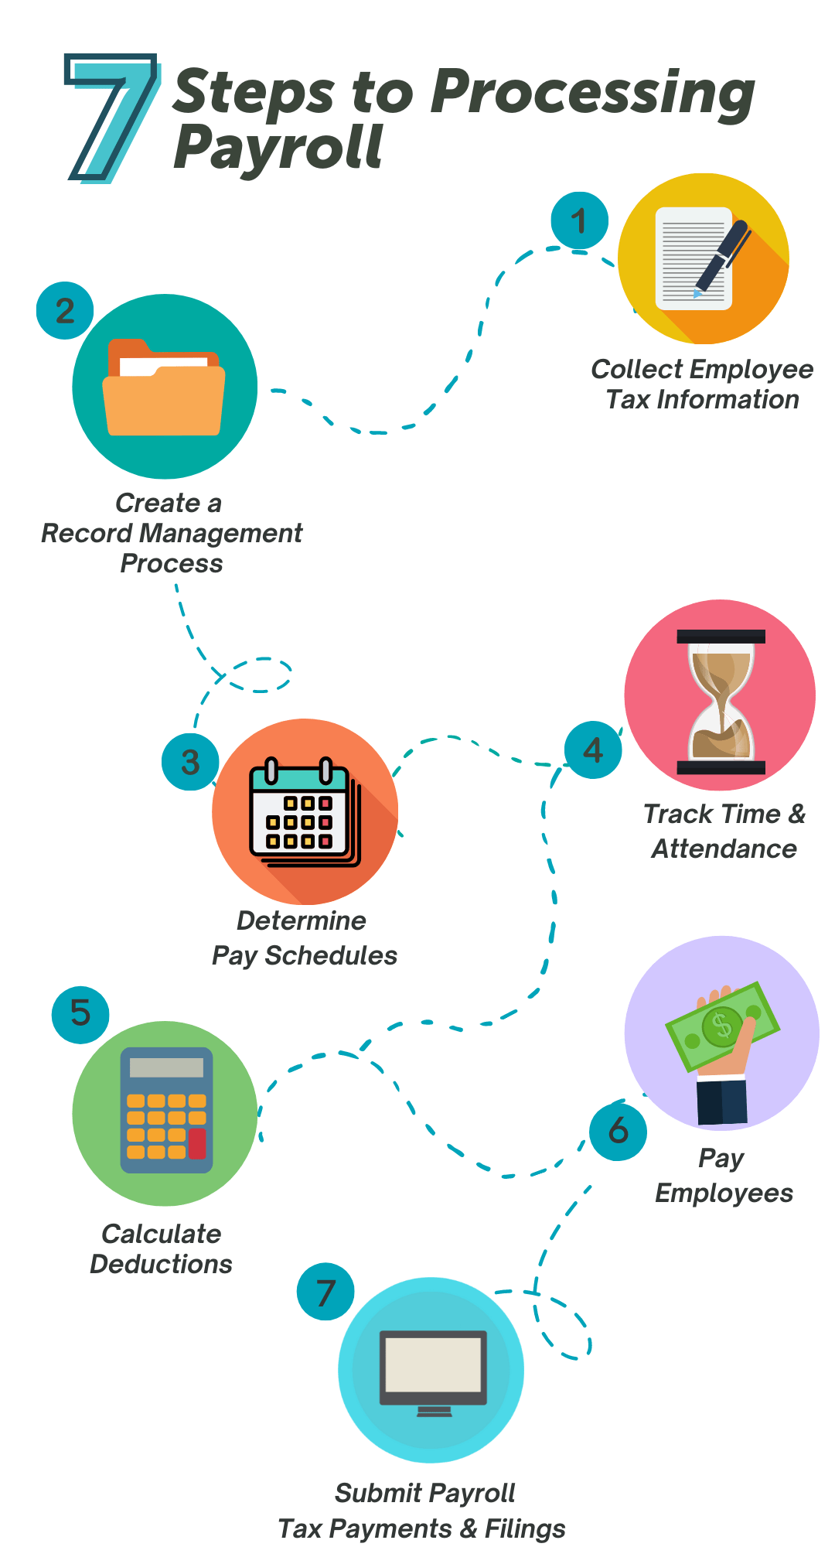
Salary process

Slide 7
OUR SOLUTION AND ITS VALUE PROPOSITION
CONDITIONAL FORMATTING – MISSING VALUES
FILTER-FILTER OUT MISSING VALUES
PIVOT TABLE- SUMMARY OF DATA
GRAPH- DATA VISUALISATION

Slide 8
DATA SET DESCRIPTION
Employee Data Set – Kaggle
Features- 21
Considered-7
Name- Text
Provident Fund-numerical
D.A- Numerical
Gross Salary- Numerical
Net Salary- Numerical

Slide 9

THE “ WOW ” IN OUR SOLUTION
=SALARY IFS(G15>=29182, “ VERY HIGH”,G15>=4, “HIGH”,G15>=13, “LOW”)

Slide 10
MODELLING
DATA COOLLECTION
Download kaggle
Edunet dashboard- file download
FEATURES COLLECTION
1.Employees name
2.Basic salary
3.Dearness allowance
4.Travelling allowance
5.Gross salary
6.Provident fund
7.Net salary
USING PIVOT TABLE
GRAPH FOR SUMMARY

Slide 11
RESULTS

Slide 12

CONCLUSION
The Salary Statement Provides A Clear Breakdown Of The Employee’s Total Earnings, Including Basic Pay, Allowances And Bonuses, Along Side Statutory And Other Deduction.
The Net Salary Payable Is Calculated After On Applicable Deductions.
This Statement Ensures Transparency And Accuracy In Salary Disbursement Supporting Both The Employee And Employer In Finacial Planning.

